Slide 1
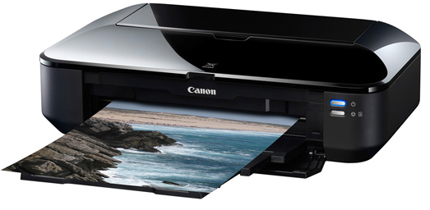
Printers
Printers
Printers
A printer is an output device that takes inputs from the computer. On the computer when you send something to print. The printers CPU then processes your input and then does the correct output required. Printing your photo.
You get different types of
printers for example
laser printer, inkjet printer,
line printer and 3D printer.

